Slide 1


The EHS Open Abdomen Registry

Slide 2
www.ehs-openabdomen.com

Slide 3
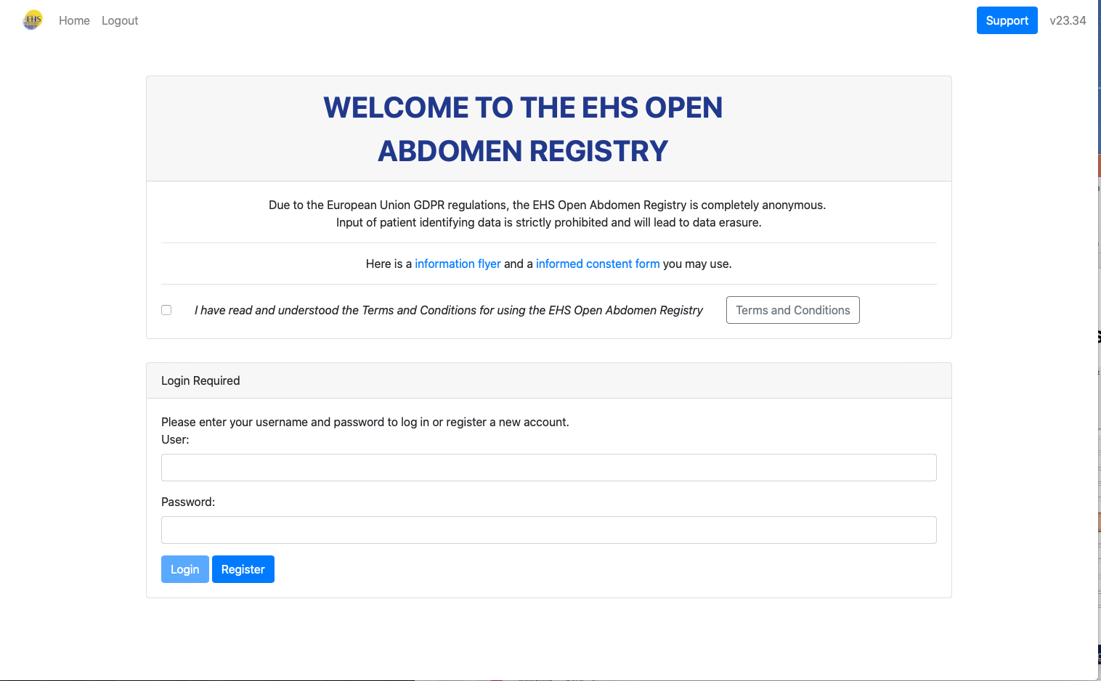
Create an account by clicking “Register” Don’t forget to accept the terms of use by ticking the box before you can log in or register.
X

Slide 4
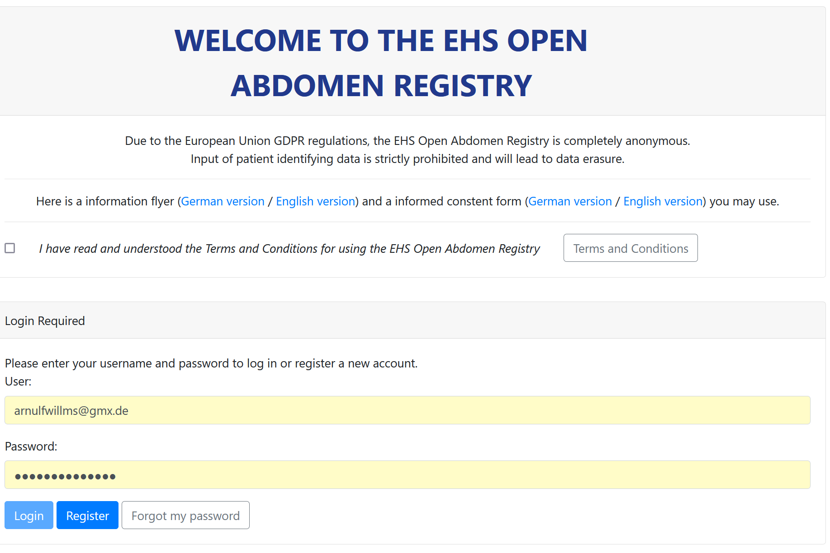
Important! Please make sure to obtain informed consent from your patients or the legal representatives. You may use the provided forms on the landing page and modify them according to your local regulations and corporate design.

Slide 5
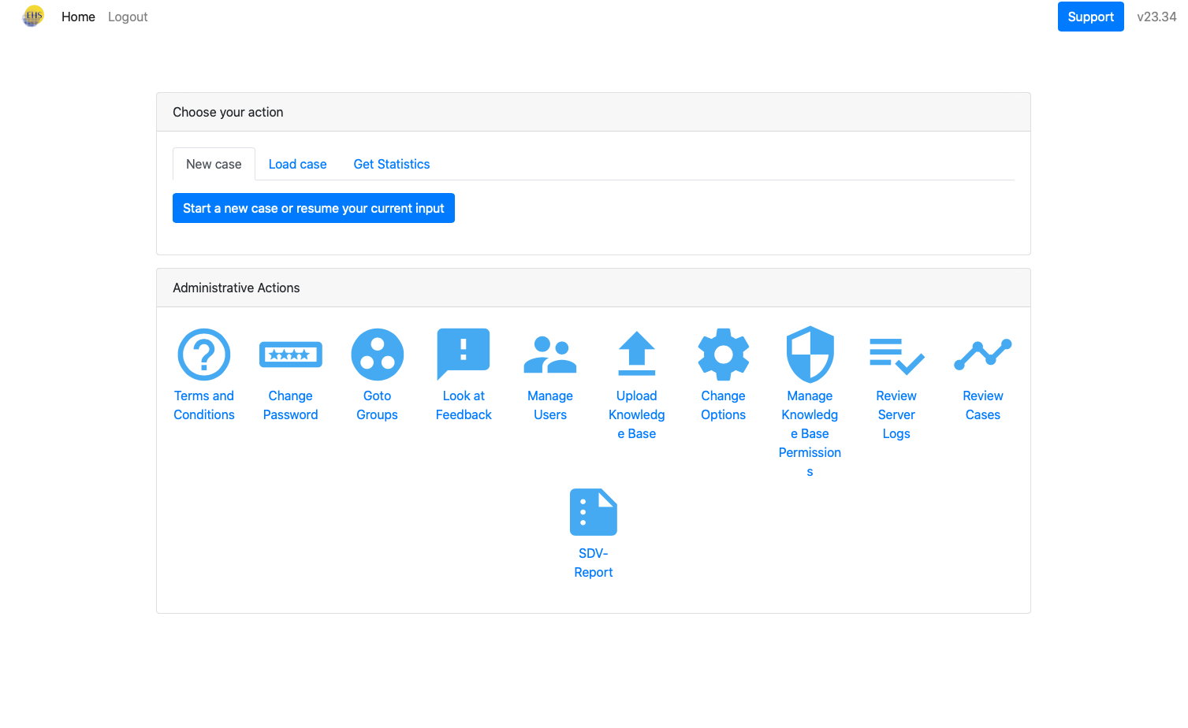
Main menu - Create a new case - Get back and add/change data in already started cases - Retrieve a data file of your entered cases
X

Slide 6
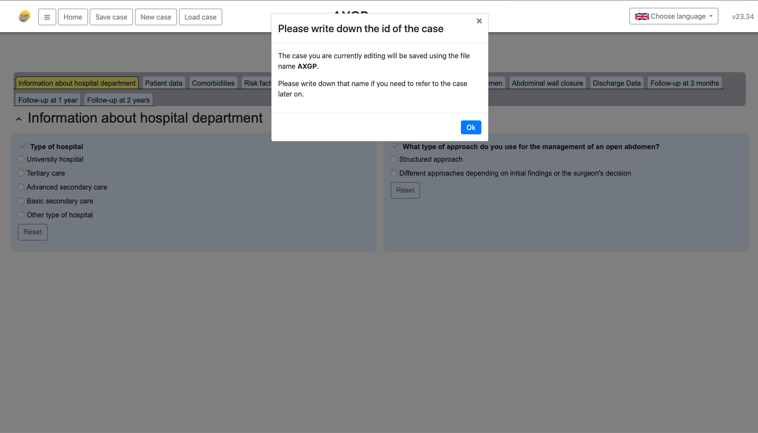
Each new case has got an assigned ID. Please write them down to identify your cases.
X

Slide 7
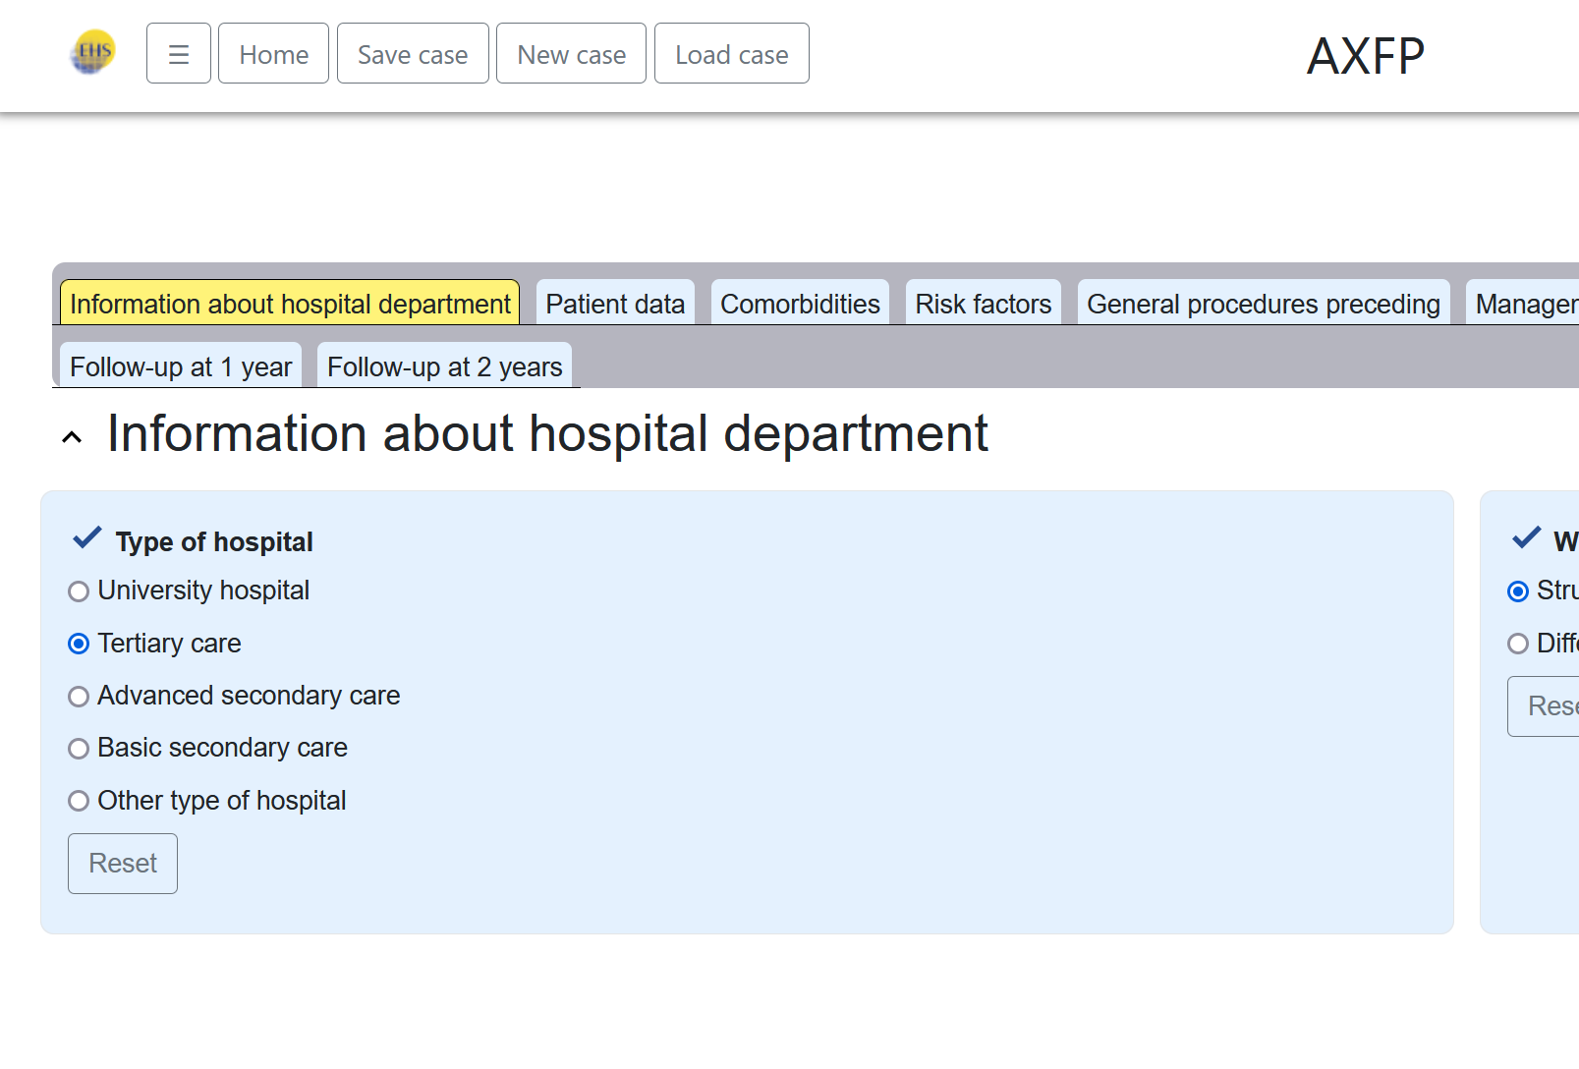
Don‘t forget to save your changes to the data regularly.

Slide 8
9 data categories
Hospital information
Patient information
Comorbidities
Risk factors
OAT indication
OAT management
Fascial closure
Discharge
Follow up

Slide 9
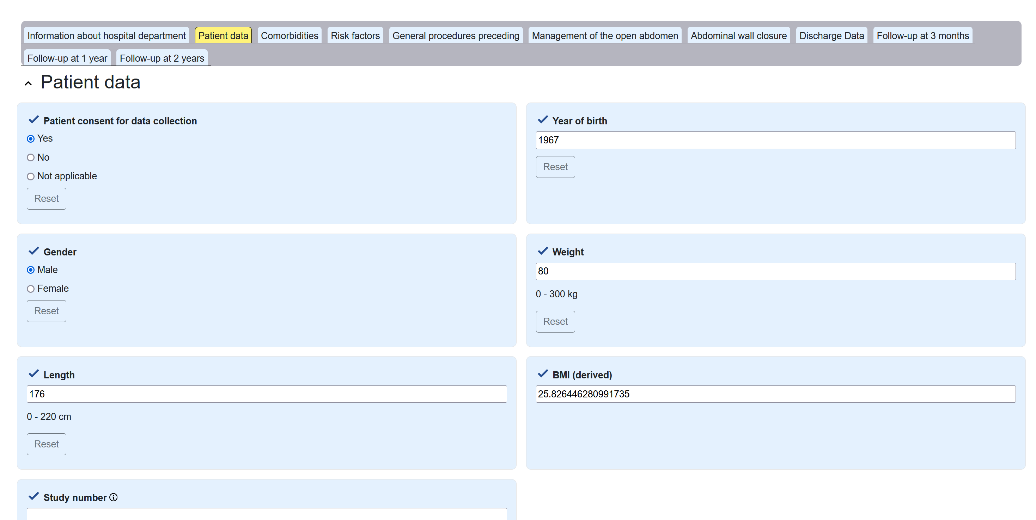
Patient data

Slide 10
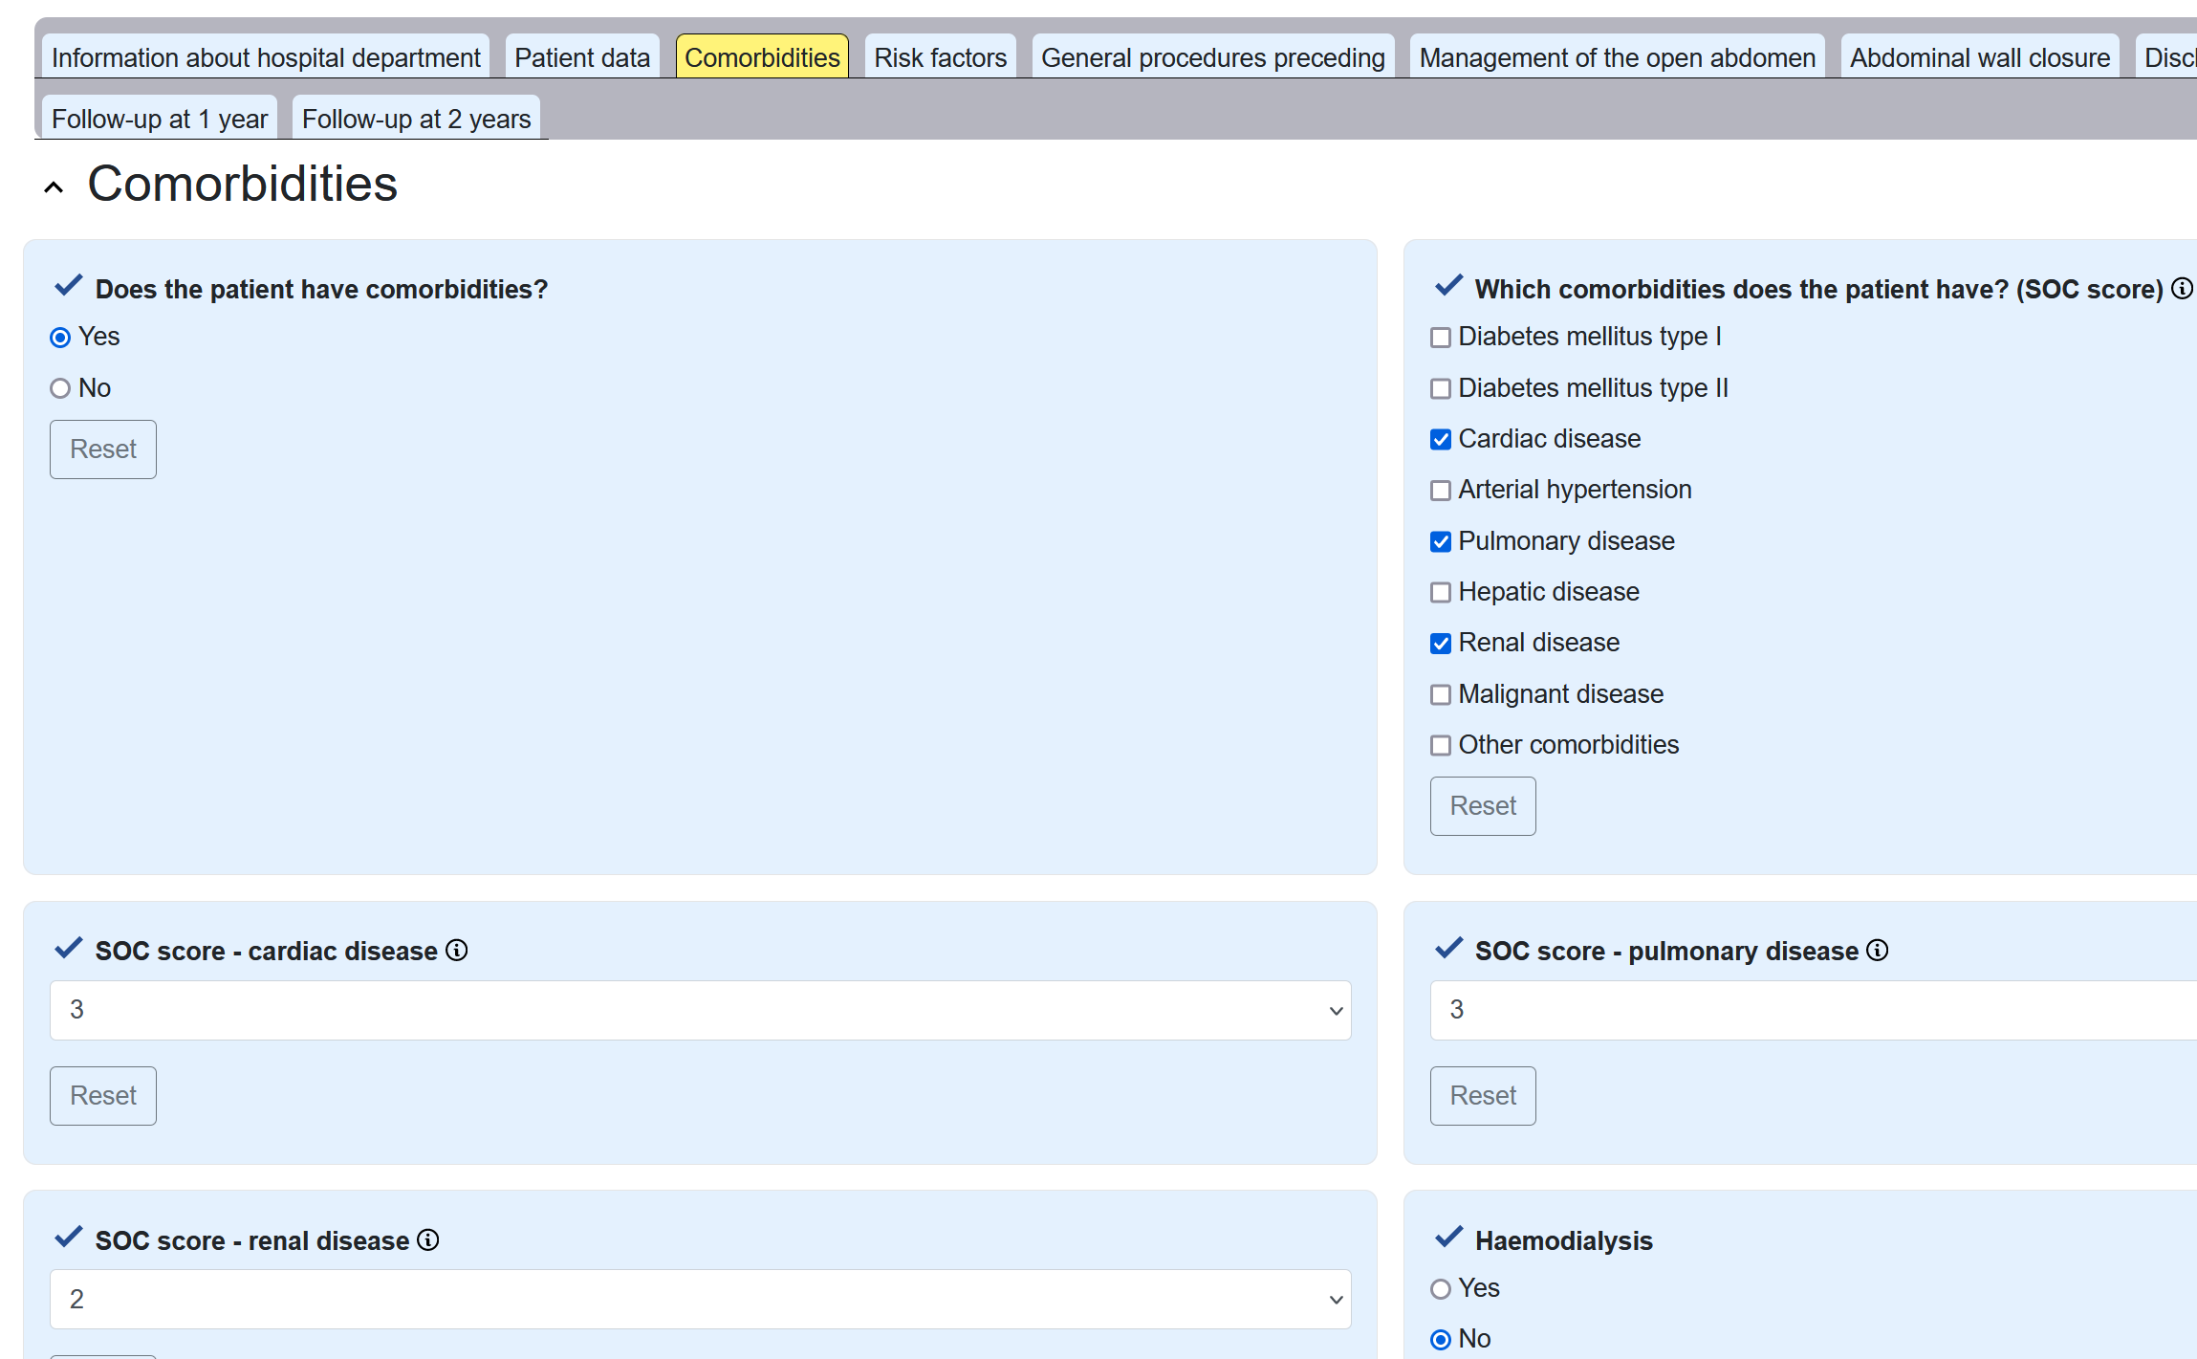
If the patient has no comorbidities, you will be directed to the next category. If yes, more fields to enter the data will appear. Additional information is available via the info icon (e.g. for scores).
Comorbidities

Slide 11
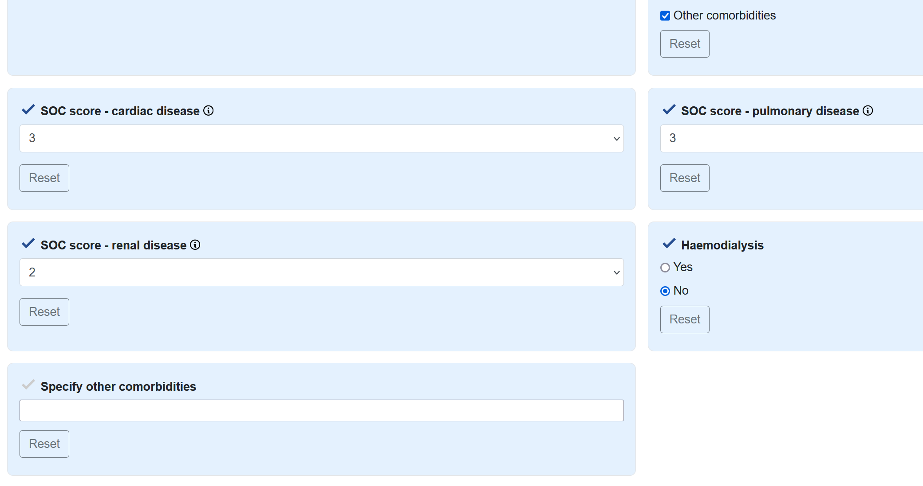
Other comorbities can be specified in a free text field.
Comorbidities

Slide 12

Categorized comorbidities are asked to be graded according to there severety (SOC score)
Comorbidities

Slide 13
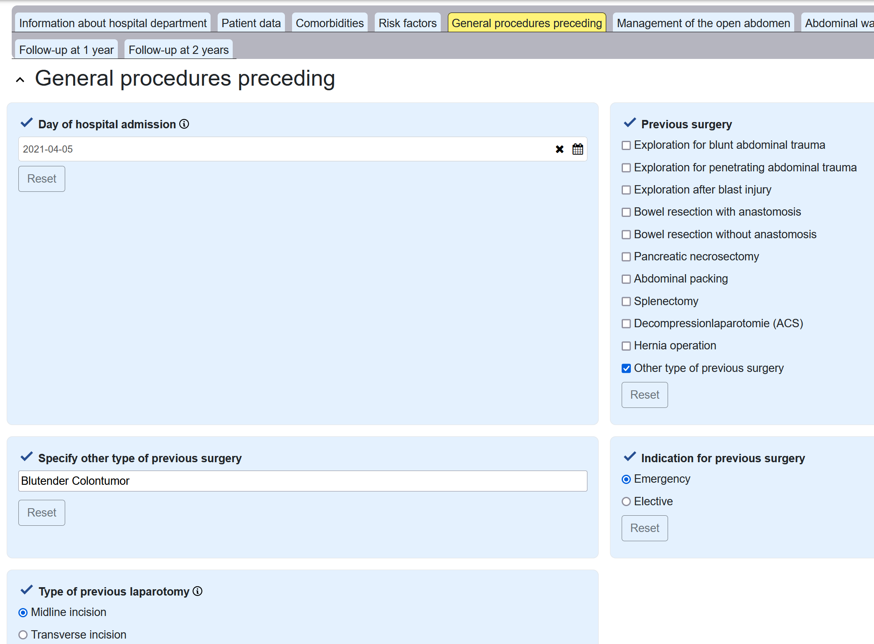
Previous surgery is considered to be a procedure that leads to secondary surgery with the need for OAT (e.g. bowel resection with anastomosis, anastomotic leakage and OAT due to secondary peritonitis)
General procedures
preceding

Slide 14
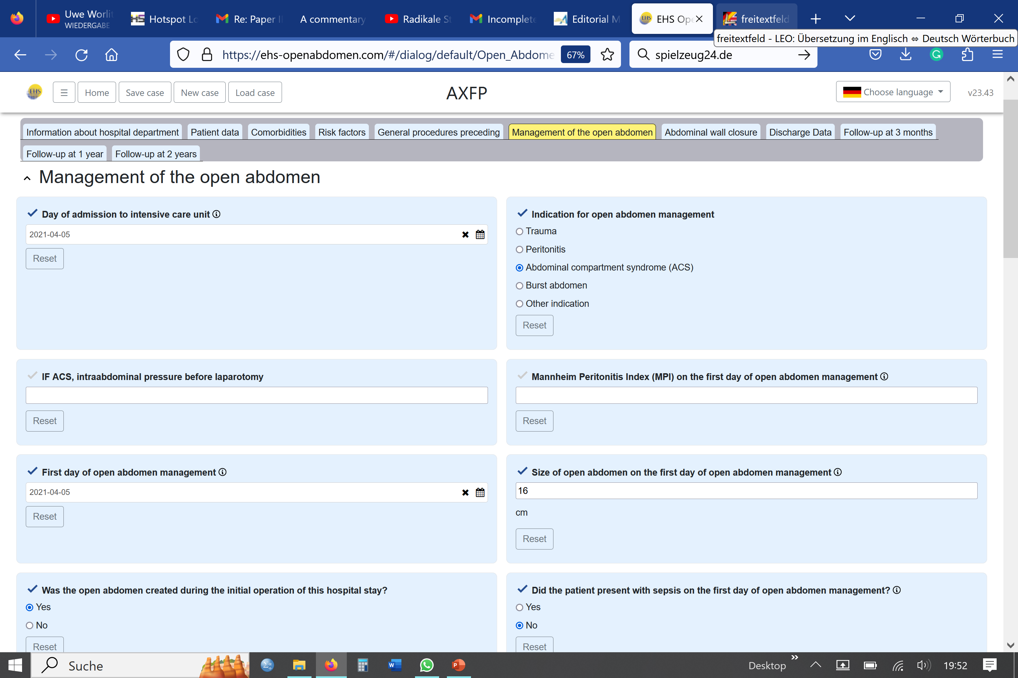
This is a key category of the registry. Please take care of entering the correct dates. The indication of the OAT can be given as trauma, peritonitis, ACS, burst abdomen or other (free text)
Management of the open abdomen

Slide 15
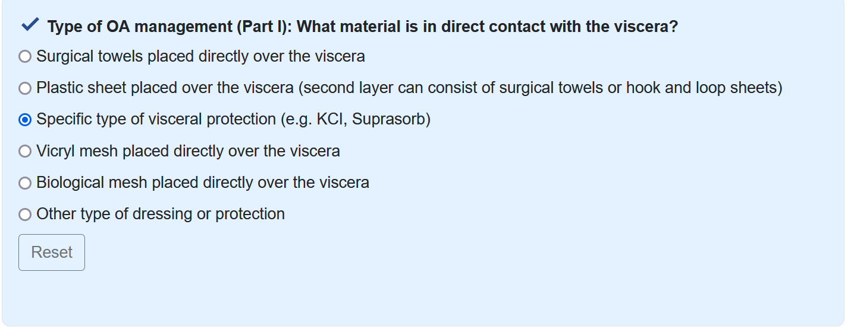
1. Which material has direct contact to the intestines? 2. Fascial traction applied? 3. Negative-pressure wound therapy used?
Three keyquestions of open abdomen management

Slide 16


1. Which material has direct contact to the intestines? 2. Fascial traction applied? 3. Negative-pressure wound therapy used?
Three keyquestions of open abdomen management

Slide 17
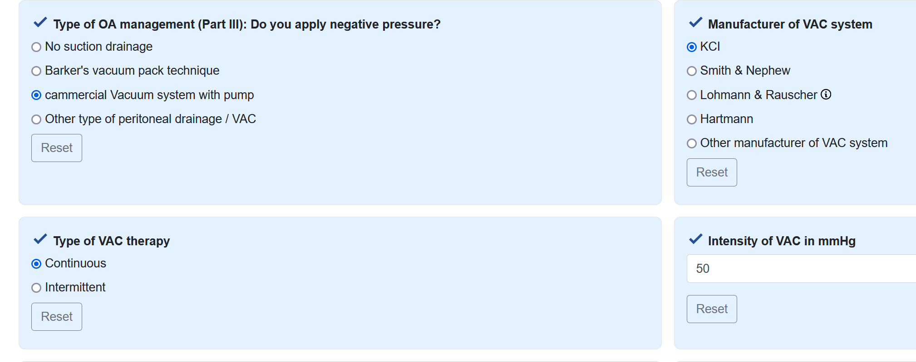
1. Which material has direct contact to the intestines? 2. Fascial traction applied? 3. Negative-pressure wound therapy used?
Three keyquestions of open abdomen management

Slide 18
5 classifications are used
Mannheim Peritonitis Index (MPI)
APACHE II
Injury Severity Score (ISS)
Clavien-Dindo classification
Björck classification (amended version of 2016)

Slide 19
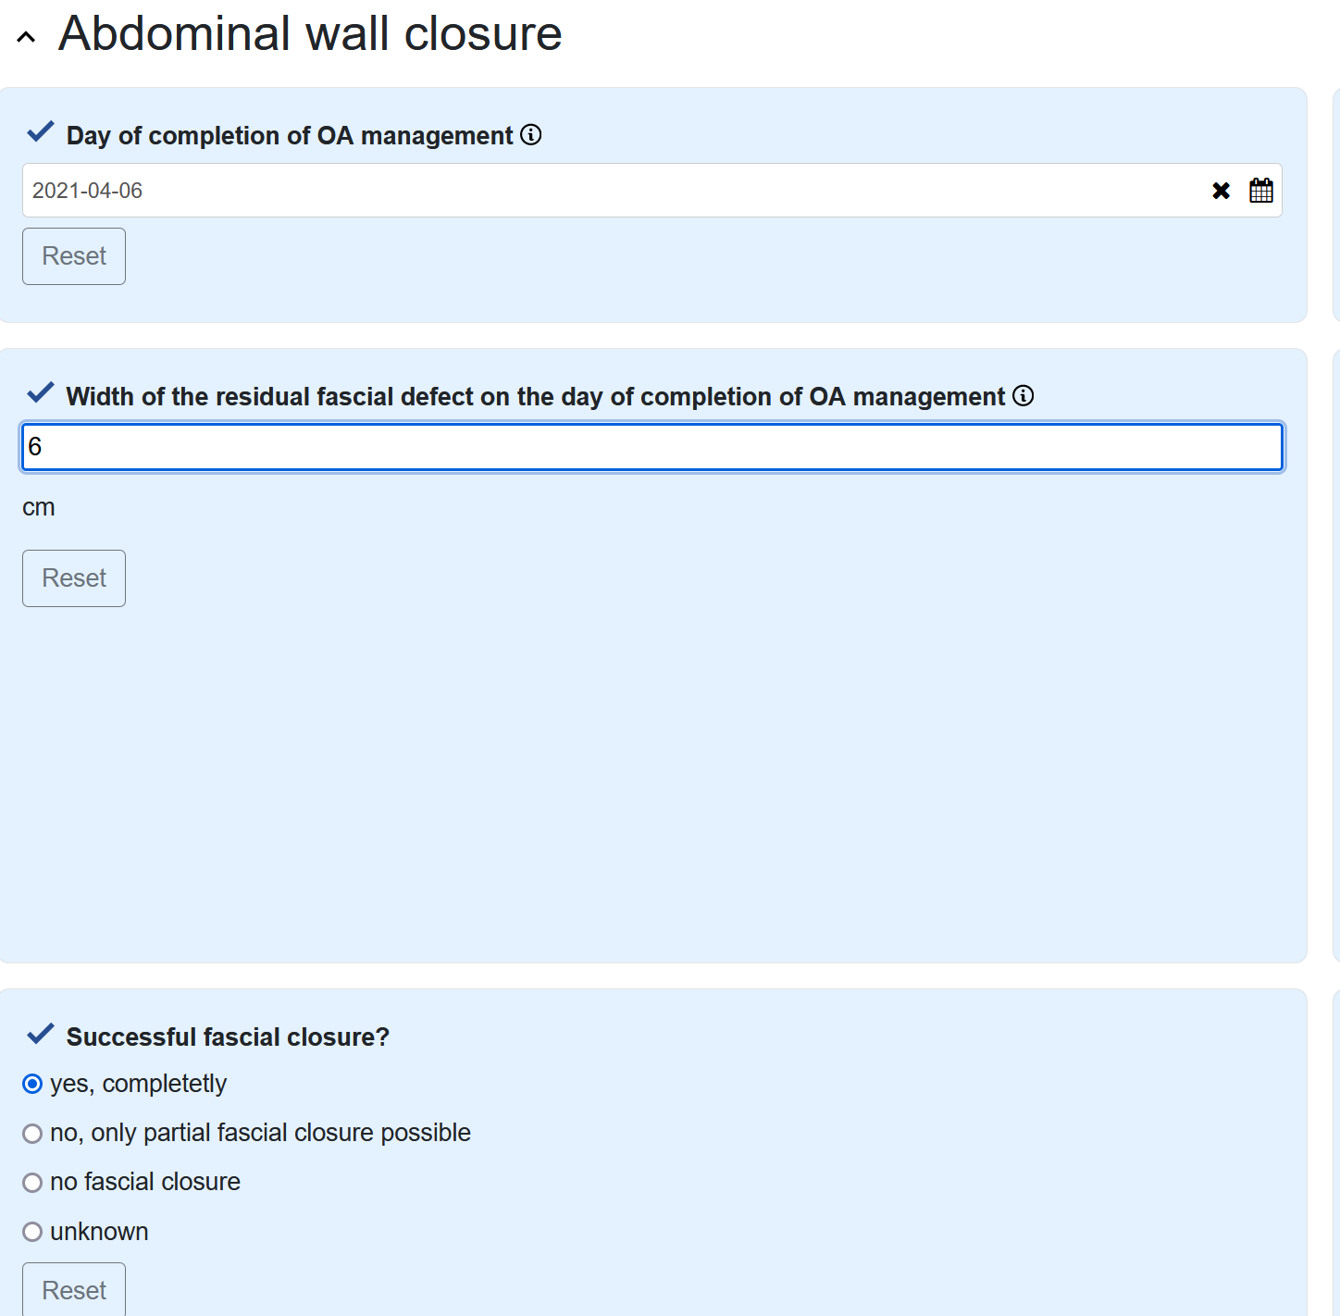
Residual dehiscence on the day of end of the OAT Dehiscence is referred to as the gap (cm) between the facial edges, not the incisional length.
Abdominal wall closure

Slide 20
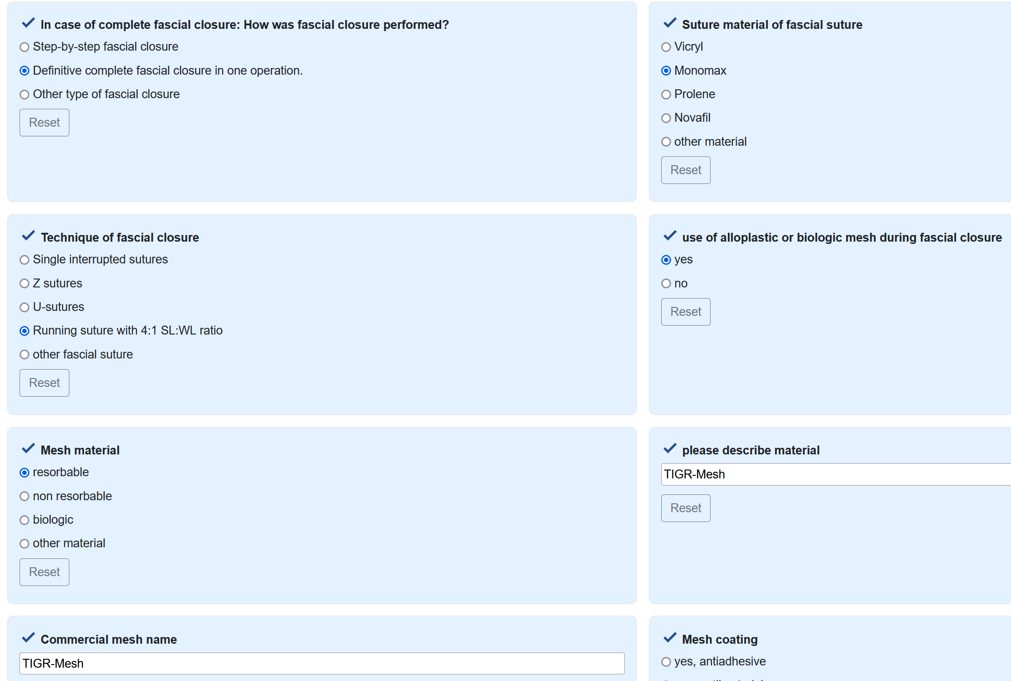
Detailed information on how fascial has been performed
Abdominal wall closure

Slide 21
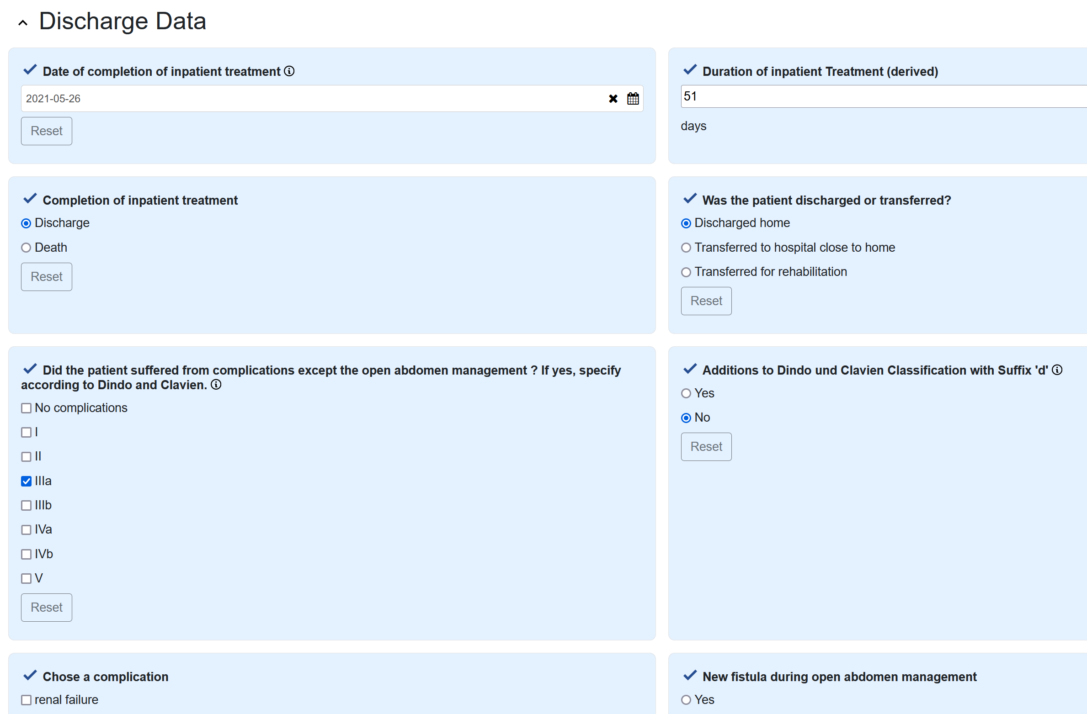
Information on complications and fistula development
Outcome - Discharge data

Slide 22
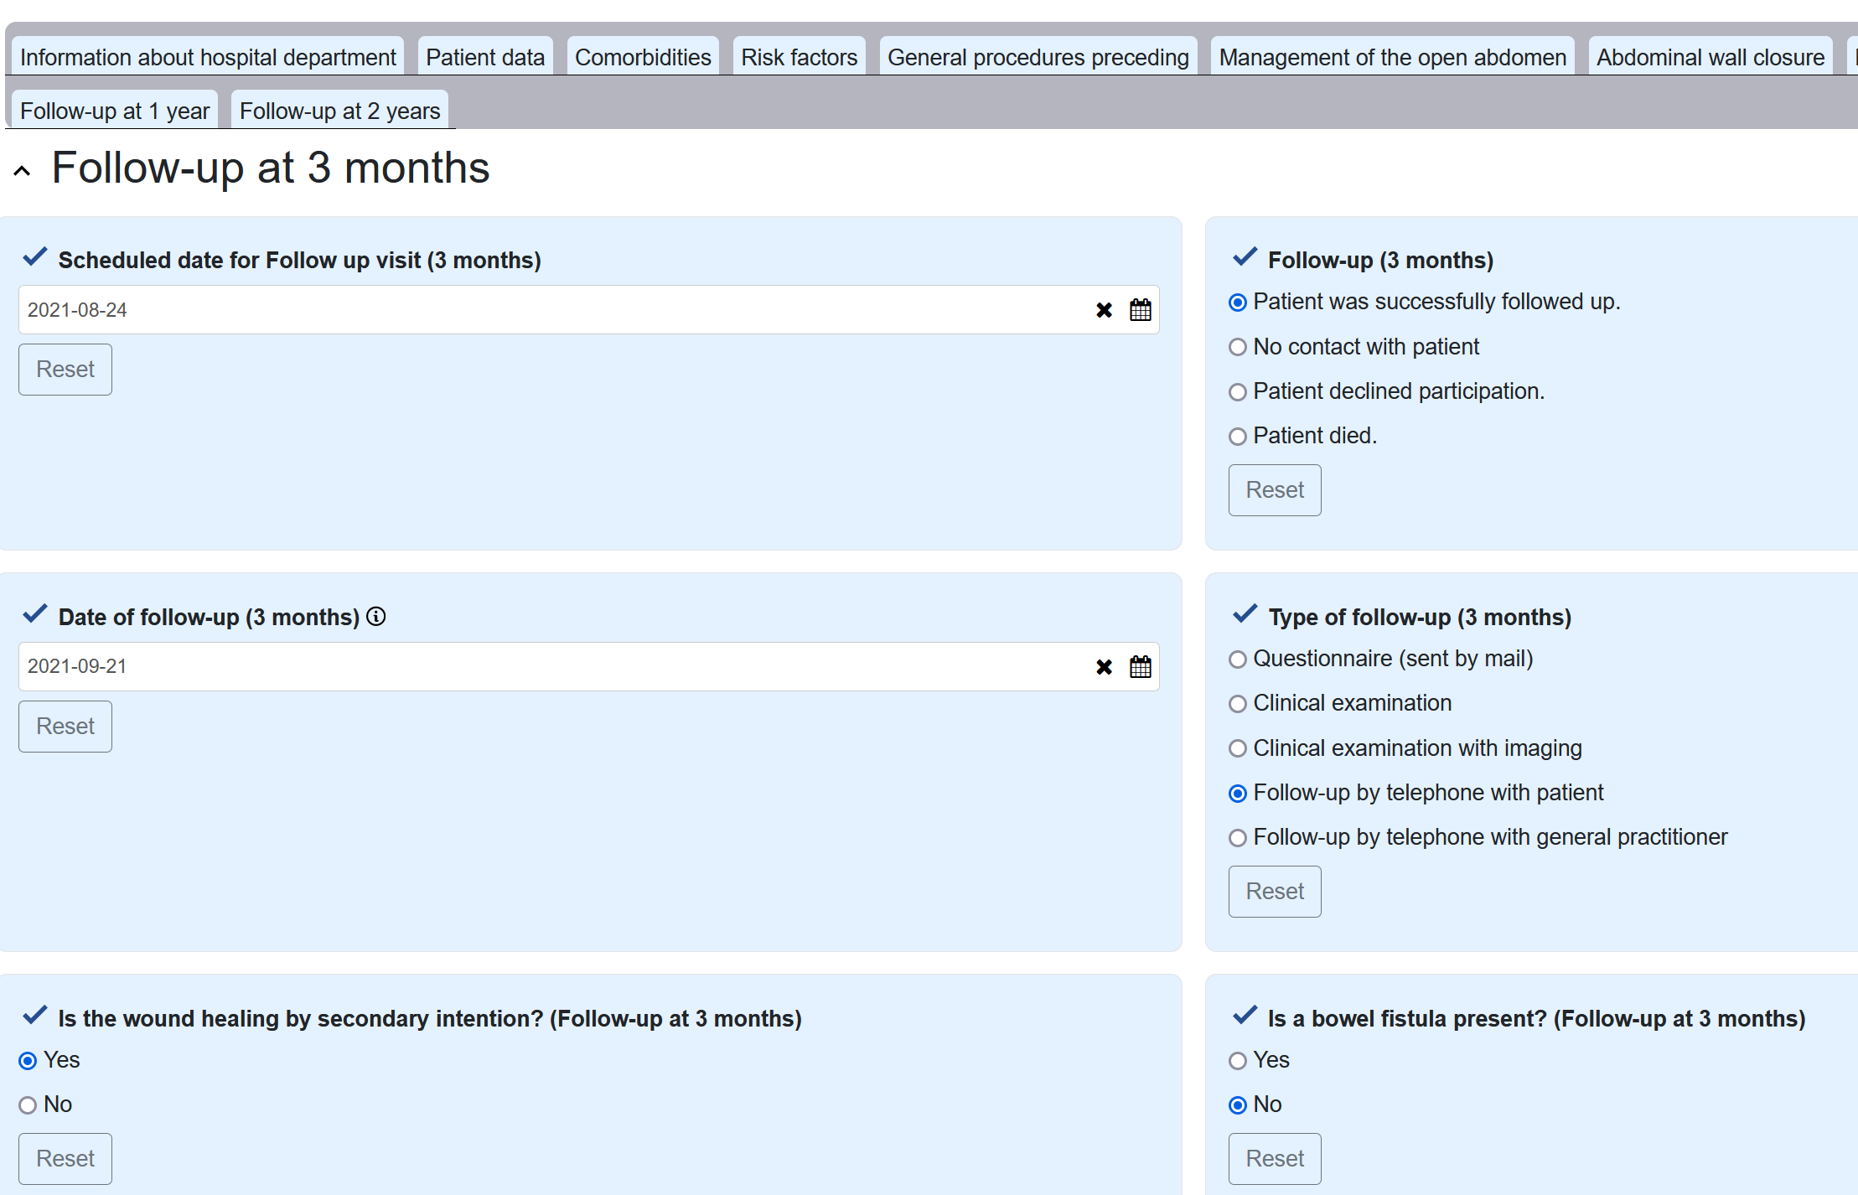
The follow up can be done by telephone, or more reliable if the patient reports to the outpatient unit. Nine follow up questions are asked. The data can be entered later via „Load case“ in the main menu.
Follow-ups after 3 months, 1 and 2 years

Slide 23
Thank you for your contribution!
In case you you encounter difficulties or have any questions, write us an email!
arnulfwillms@bundeswehr.org
sebastianschaaf@bundeswehr.org

